Slide 1
Exposys data labs
CUSTOMER SEGMENTATION PROJECT
Presenter’s name : Bahaduri Prachiti Jagdish
Position : Data Science Intern

Slide 2
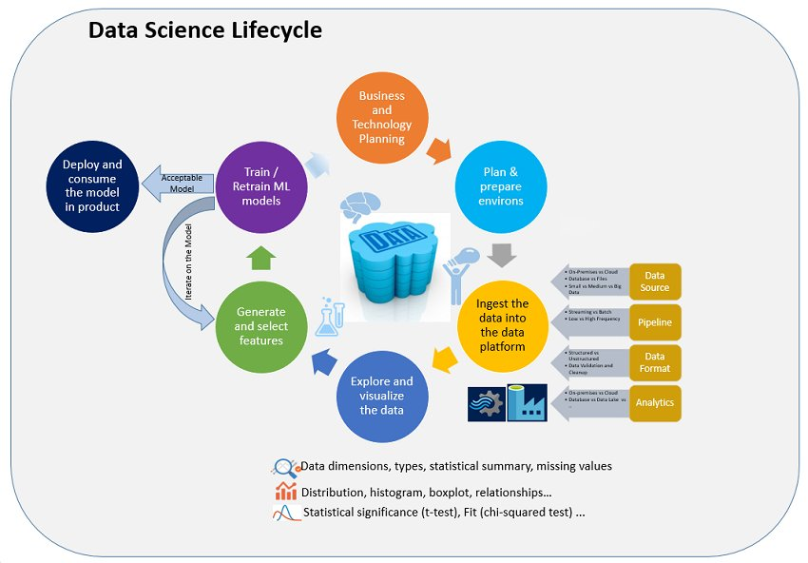
Data Science is an inter – disciplinary that uses scientific methods, processes, algorithms to extract knowledge and insights from many structural and unstructured data.
DATA SCIENCE

Slide 3
CUSTOMER SEGMENTATION
Customer Segmentation enables a company to customize its relationship with its customers.
The basic characteristics and needs are generalized into groups using various strategies viz,
Targeted marketing activities to specific groups
Launch of features aligning with the customer demand
Development of the product roadmap

Slide 4
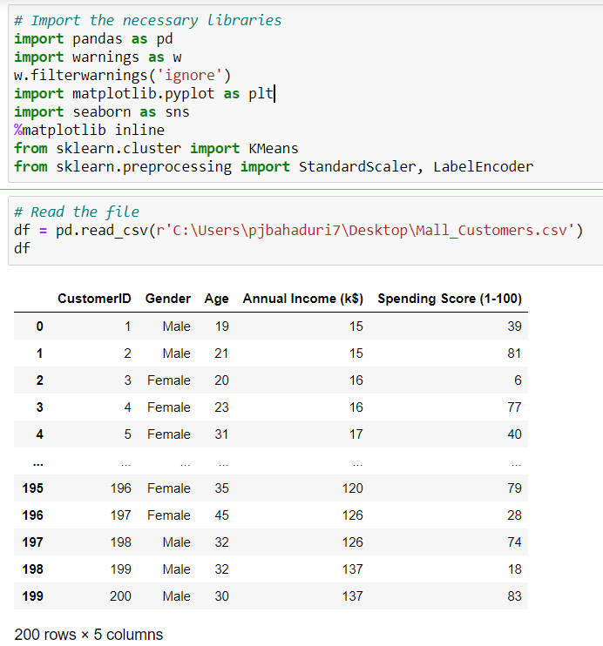
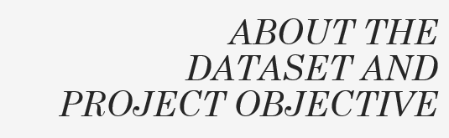
The code is written in Python of V3.7.6
The required modules are imported with the respective versions
Pandas – V1.0.1
Matplotlib – V3.1.3
Seaborn – V0.10.0
Scikit – learn – V0.22.1
The attributes of the dataset are the basic characteristics and needs of the customer.
The main aim of the project is to use Unsupervised Learning via K means technique to identify segments of customers using clusters.

Slide 5
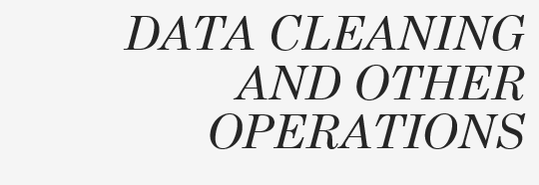
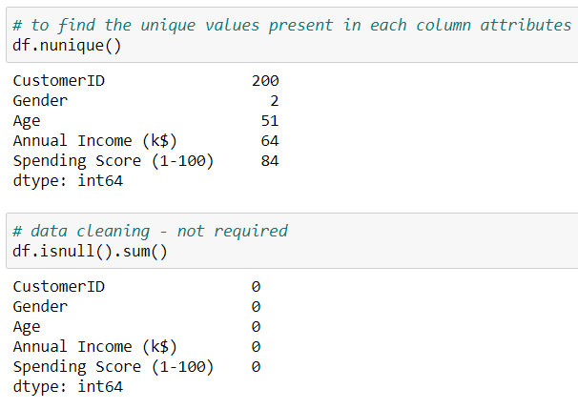
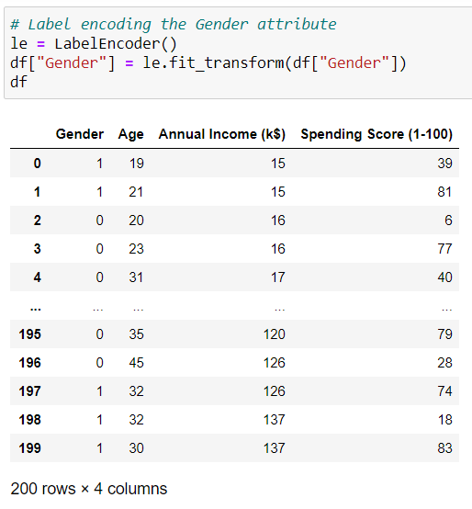
The dataset is checked for the presence of null values.
Also the number of unique values are obtained for each attributes.
The gender is label – encoded for easier analysis by calling the LabelEncoder function.

Slide 6
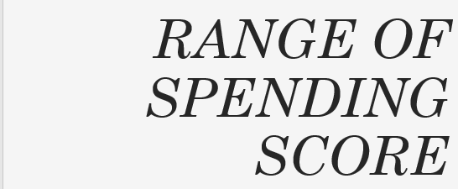
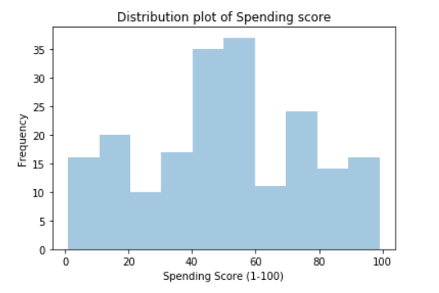
Univariate distribution of Spending Score.
The bin size between each value in the X variable is 20.
There is a rise in the count when score is in the range of 40 and 60.
The least count of 10 is in the score range of 20 to 30.

Slide 7
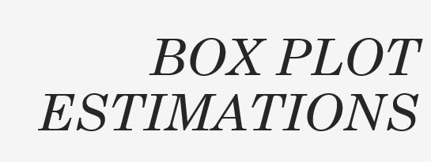
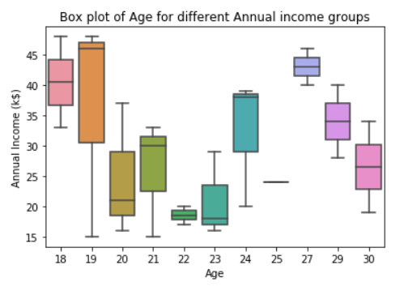
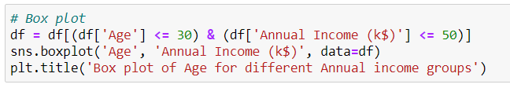
A standardized way of displaying a dataset.
Maximum annual income is 48$ - age 18 and 19 Minimum income is 15$ for the ages 19 and 21.
Equal number of customers who have surpassed first and third quartile regions are of the age 18, 27, 29, 30.
No sign of outliers.
25 percentile surpassed customers with age 19, 21 and 24 with income 31$, 22$ and 28$ respectively.
The interquartile region is more for age 20 with income 28$.

Slide 8
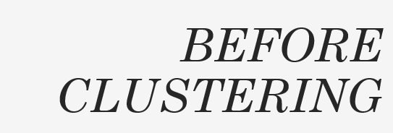
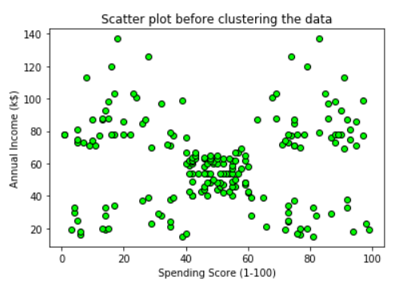
A type of plot using cartesian coordinates to display values.
Scatter plot is used to map out a better relationship between the two numeric variables.
Suggests various kinds of correlations between variables with certain confidence interval.

Slide 9
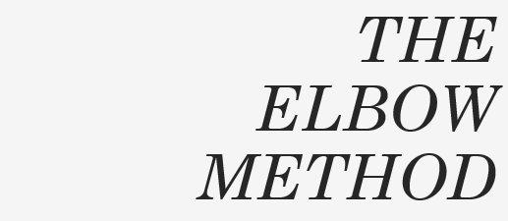
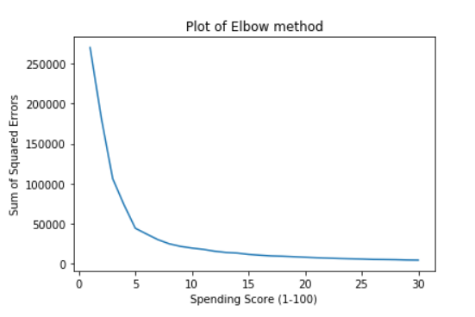
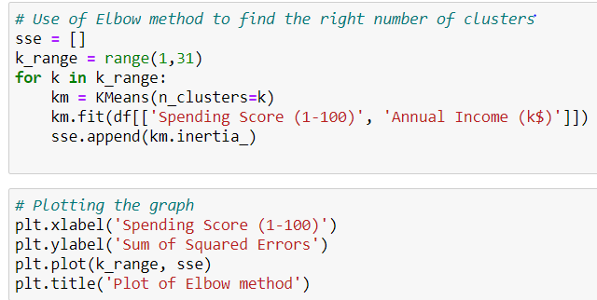
A heuristic used in determining the number of clusters in the dataset.
Pick the elbow of the curve as a number of clusters.
Sum of squared errors has to be minimized for the given set of centroids.
It is evident that the k value is 5.

Slide 10
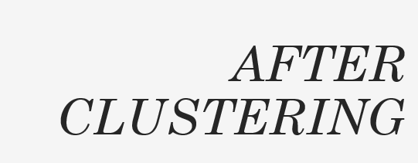
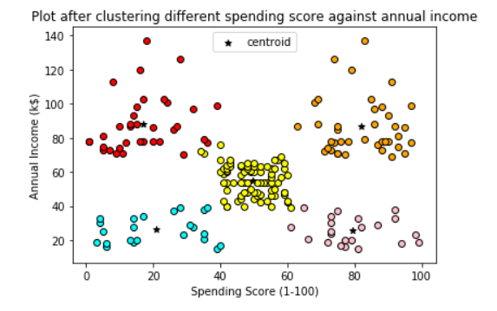
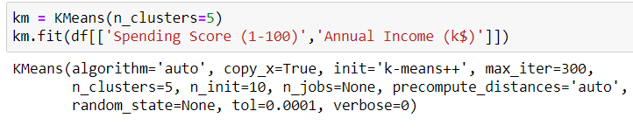
Cyan coloured cluster
Spending Score – 0 to 40 within 20$ to 40$ of income.
Red coloured custer
Spending score – 0 to 40 within income 80$ to 140$
Yellow coloured cluster
Spending score – 40 to 60 within income 40$ to 70$
Orange coloured cluster
Spending score – 60 to 100 within income 20$ to 40$
Pink coloured cluster
Spending score – 60 to 100 within income 78$ to 140$
Finally the K means method is called and the result is acquired.

Slide 11
Thank you

